Slide 1

Cluster Computing at Princeton
Applications to political science

Slide 2
Goals of this workshop
Review details about cluster computing use on campus
Go over practical applications in political science
Gather questions and topics for guide and subsequent workshops

Slide 3
Three Systems
Della
Nobel
Adroit
Today’s Focus

Slide 4
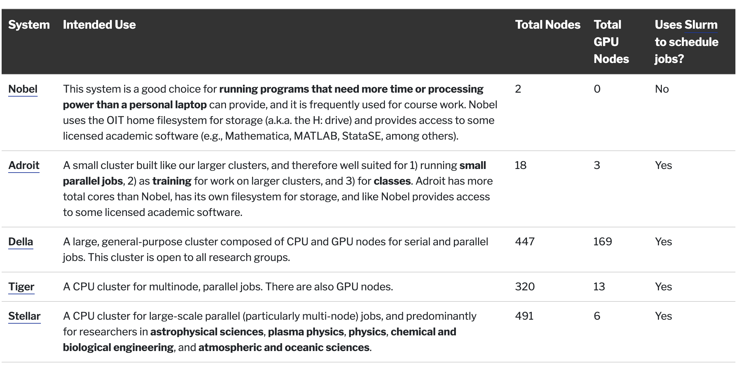
Differences between systems

Slide 5
Uses
Simulation Analyses
Bayesian Models with Many Parameters
Hierarchical model with large data and many level
In-context classified NLP
Dealing with datasets too large for pc
Full DIME data
contribDB_2024.csv.gz is 17gb+

Slide 6
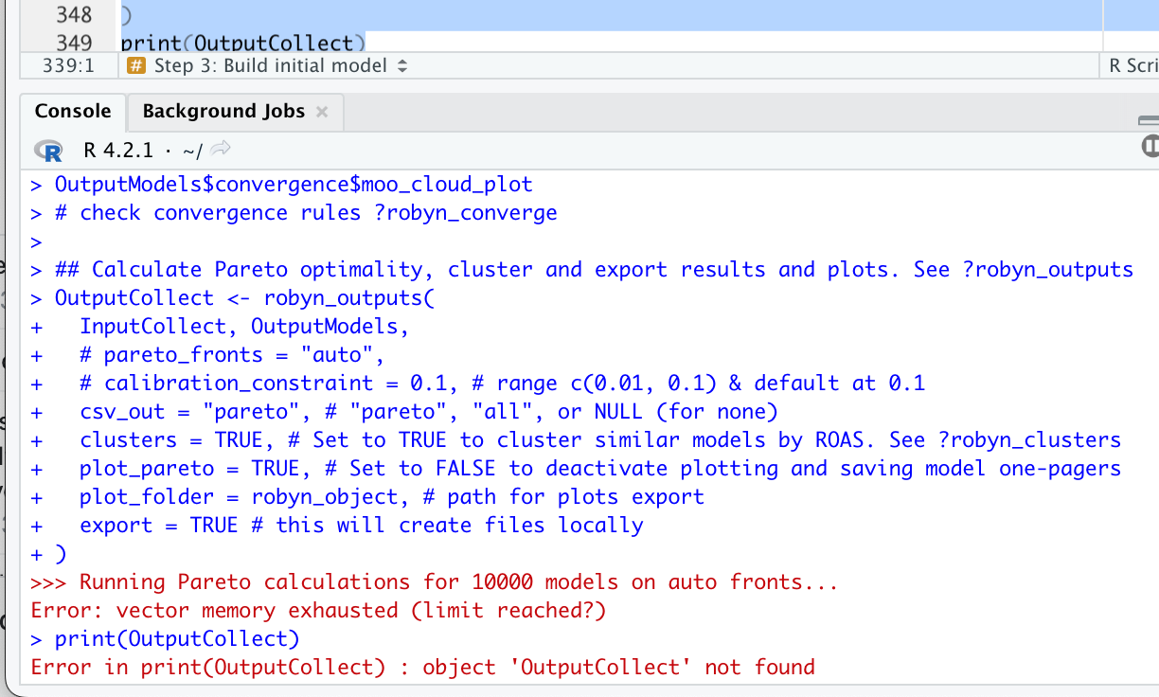

Slide 7
Simulation Analyses: Redistricting

Slide 8
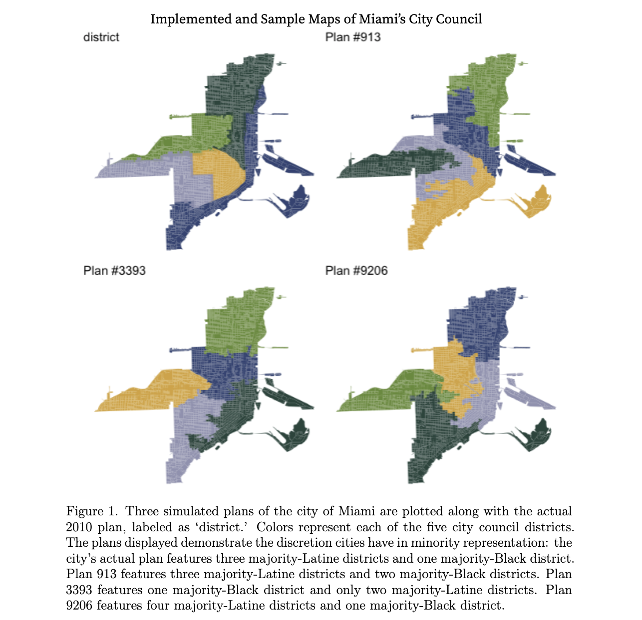

Slide 9
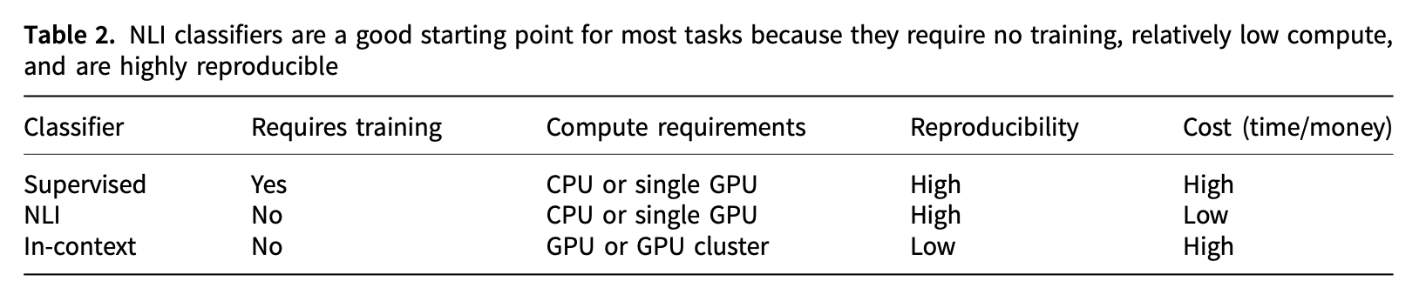
When a cluster is needed for NLP
From Burnham (2024)

Slide 10
Why Start with Adroit?
Easiest to get started with
Might be all you need depending on your memory and CPU needs
Political science uses tend to be less intensive than STEM

Slide 11
Steps to Getting Started with Adroit
Request Adroit Account
Connect to VPN if off-campus
Login via terminal
ssh userid@adroit.Princeton.edu
Navigate to appropriate directory
Run Slurm code

Slide 12
What is Slurm?
Simple Linux Utility for Resource Management
Job scheduler for all clusters except Nobel
Script framework for running your actual code

Slide 13
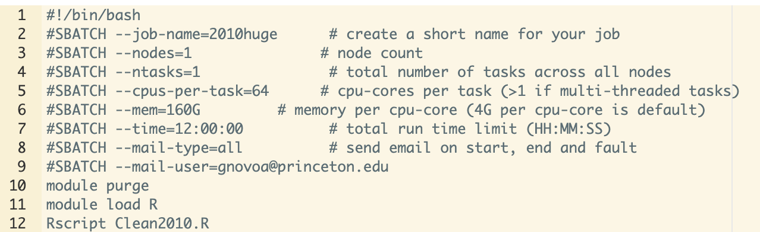
Slurm Example

Slide 14
Multithreads vs Parallel and Multinodes
Multithreaded Jobs = multiple cpus per task
Parallel = multiple tasks per node
Multinode jobs can be applied to both multithread and parallel

Slide 15
Recommend Workflow
Upload needed files to scratch directory
Test out via interactive app
Then submit via Slurm

Slide 16
Hands-on Example
Navigate to my github and download this folder:
https://github.com/gustavo-novoa/ClusterWorkshop
Try it out in interactive
Create Slurm
Submit Slurm

Slide 17
Topics for our upcoming guide
What topics are you interested in researching with the clusters?
What problems are you having if you have already started?
Is your task multithreaded or run in parallel?
(When is Adroit insufficient?)

